Slide 1
Computer Programming and Algorithms
SEMT10002
2025 / 2026

Slide 2
This Seminar
Understand that errors and bugs are a normal part of writing code
Understand that tracebacks can help us to fix bugs and errors in our code
Practice reading and understanding tracebacks
Understand the meaning of some common Python Exceptions
Practice debugging some code.

Slide 3
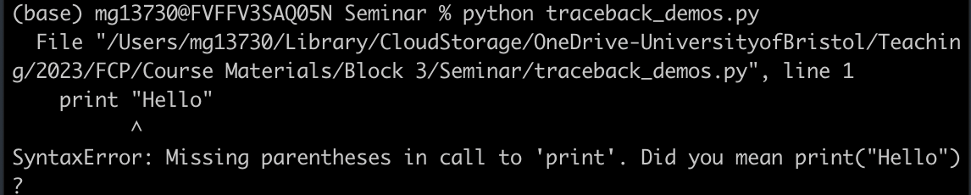
Errors & Tracebacks
Broadly, errors with our code can be divided into Syntax errors and Runtime errors.
Syntax errors occur when our code doesn’t conform to the pattern the Python interpreter expects- i.e we forget to close a bracket, or quotation mark.

Slide 4
Errors & Tracebacks
Broadly, errors with our code can be divided into Syntax errors and Runtime errors.
Syntax errors occur when our code doesn’t conform to the pattern the Python interpreter expects- i.e we forget to close a bracket, or quotation mark.

Slide 5
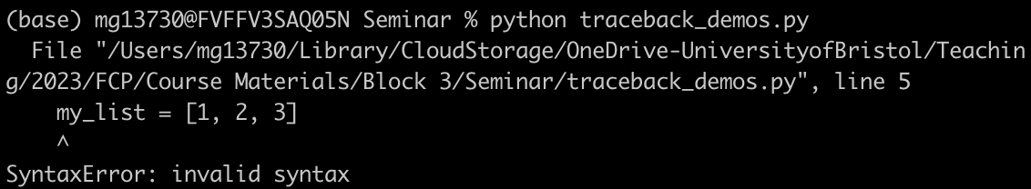
Errors & Tracebacks
Broadly, errors with our code can be divided into Syntax errors and Runtime errors.
Syntax errors occur when our code doesn’t conform to the pattern the Python interpreter expects- i.e we forget to close a bracket, or quotation mark.

Slide 6
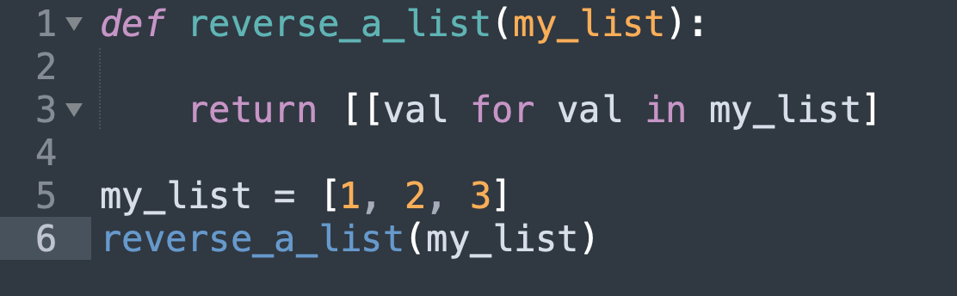
Errors & Tracebacks
Broadly, errors with our code can be divided into Syntax errors and Runtime errors.
Syntax errors occur when our code doesn’t conform to the pattern the Python interpreter expects- i.e we forget to close a bracket, or quotation mark.

Slide 7
Errors & Tracebacks
Broadly, errors with our code can be divided into Syntax errors and Runtime errors.
Syntax errors occur when our code doesn’t conform to the pattern the Python interpreter expects- i.e we forget to close a bracket, or quotation mark.
If your syntax is correct, we may still get an error when we run our code. These Runtime errors are called Exceptions.

Slide 8
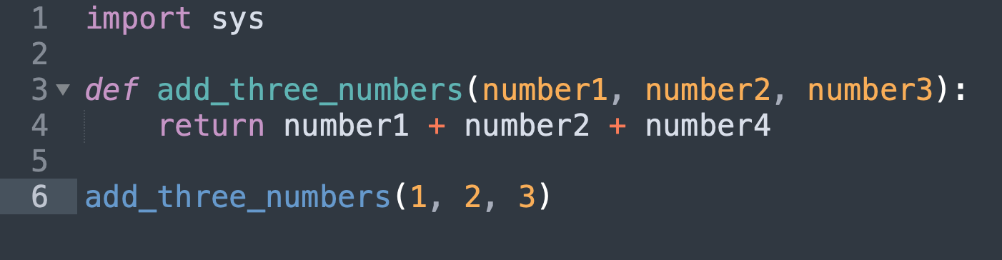
Tracebacks
When our code raises an exception, we will also get a traceback which gives us information about the cause of the exception.

Slide 9
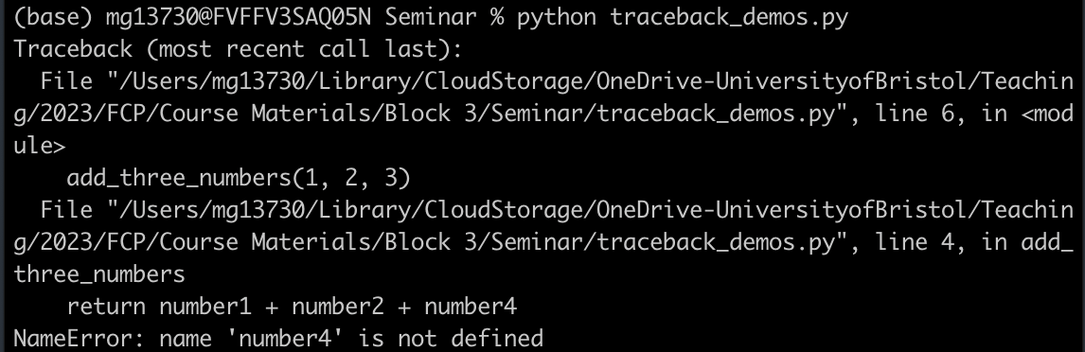
Tracebacks
When our code raises an exception, we will also get a traceback which gives us information about the cause of the exception.

Slide 10
Tracebacks
When our code raises an exception, we will also get a traceback which gives us information about the cause of the exception.
When our code produces an exception, we can use the traceback to find out what type of exception was raised, and what lines of code causes the exception

Slide 11
Tracebacks
When our code raises an exception, we will also get a traceback which gives us information about the cause of the exception.
When our code produces an exception, we can use the traceback to find out what type of exception was raised, and what lines of code causes the exception.

Slide 12
Tracebacks
When our code raises an exception, we will also get a traceback which gives us information about the cause of the exception.
When our code produces an exception, we can use the traceback to find out what type of exception was raised, and what lines of code causes the exception.

Slide 13
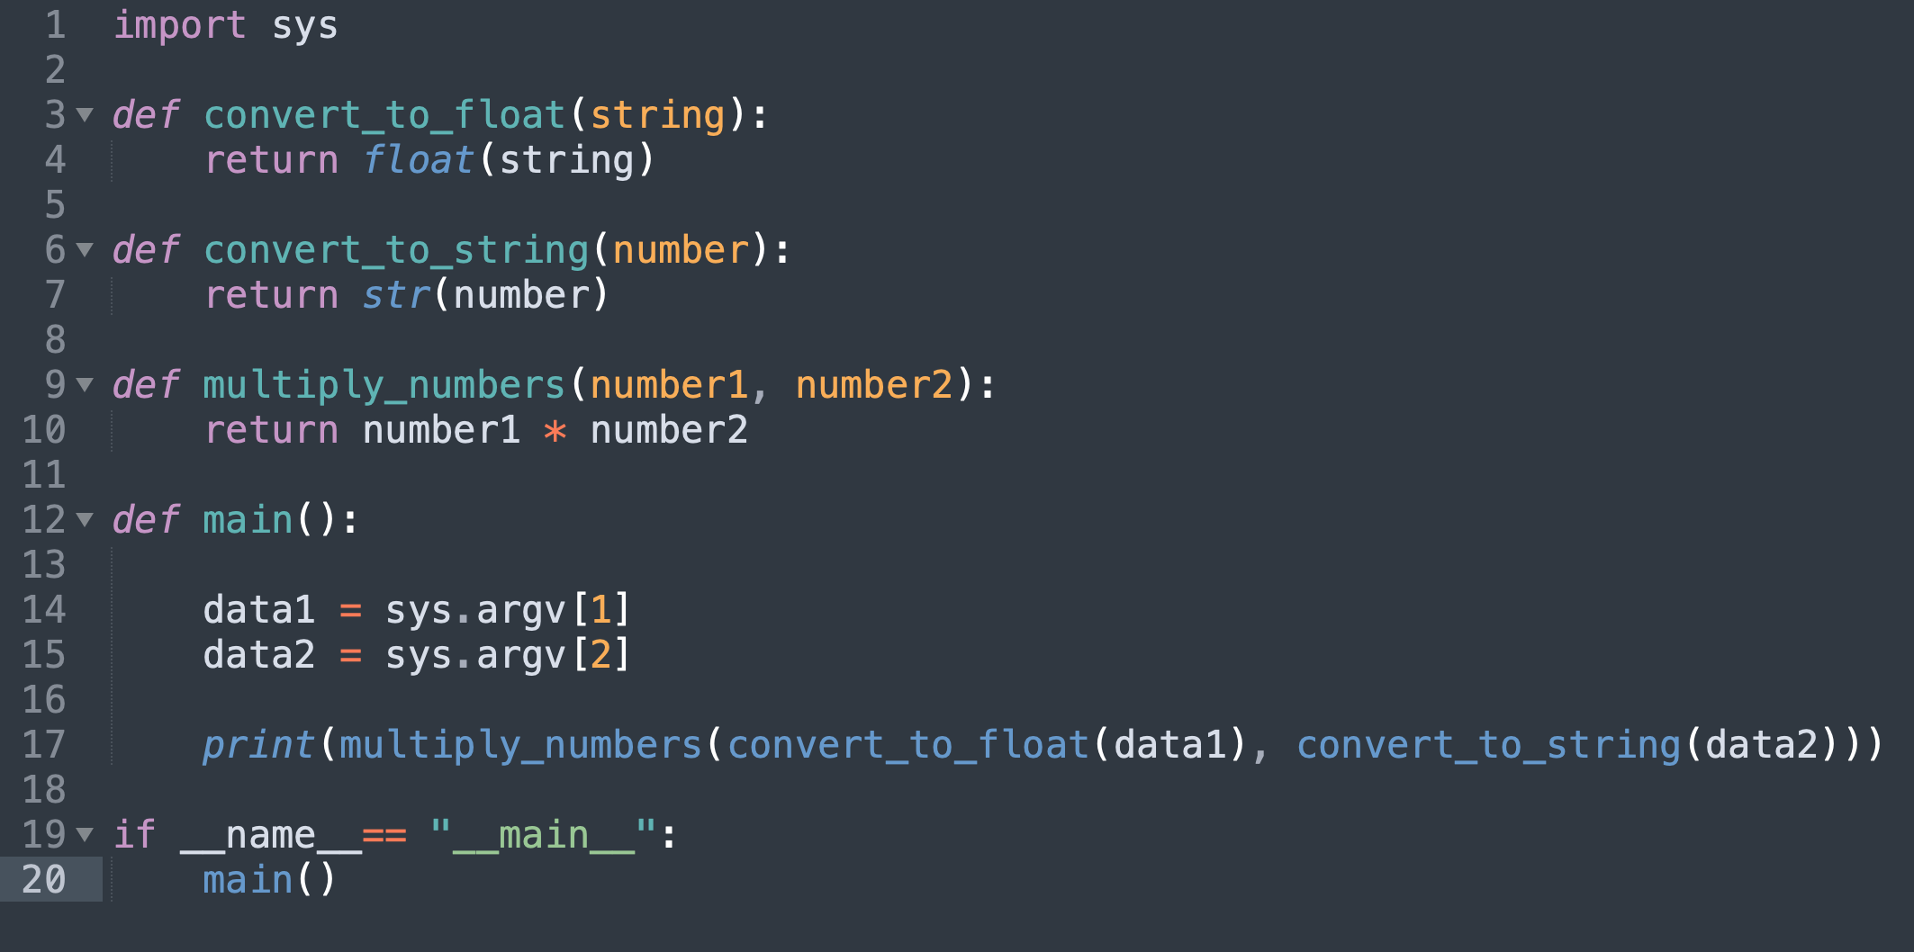
Tracebacks

Slide 14
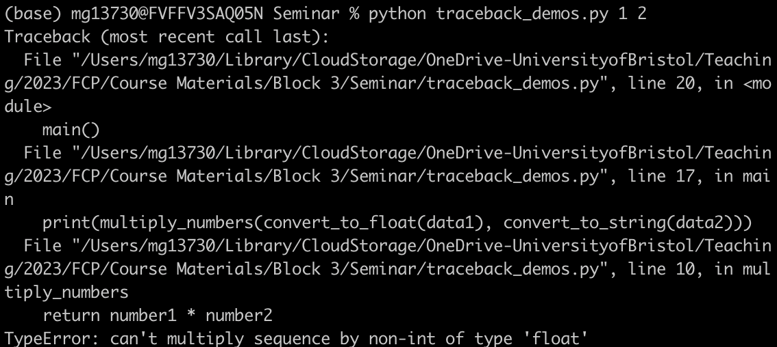
Tracebacks

Slide 15
Tracebacks

Slide 16
Tracebacks

Slide 17
Tracebacks

Slide 18
Common Exceptions
IndexError – we’ve tried to access a list element with an index that doesn’t exist.
KeyError – we’ve tried to access a dictionary with a key that doesn’t exist.
NameError – we’ve tried to use a variable we haven’t defined.
UnboundLocalError – we’ve tried to use a variable we haven’t defined in a function.
TypeError – we’ve called a function or operator with a variable of the wrong type.
ValueError – we’ve called a function with a variable that has the wrong value.

Slide 19
Examples
Debug the three samples on Blackboard
  Debug1.py
  Debug2.py
  Debug3.py

